Slide 1

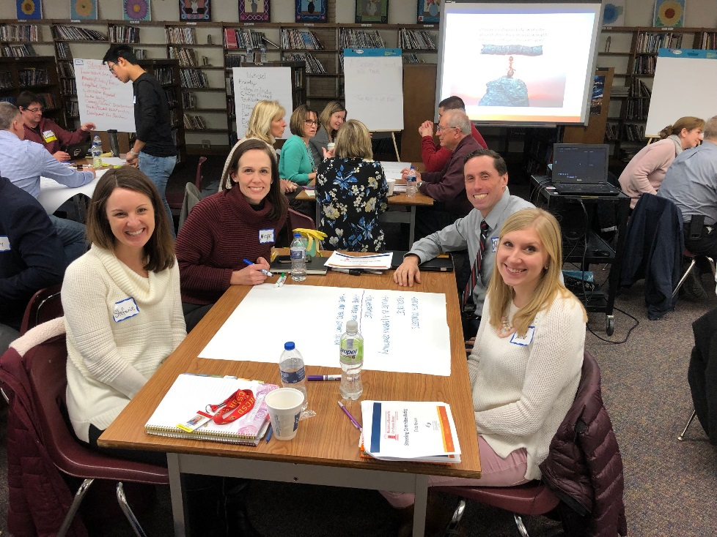
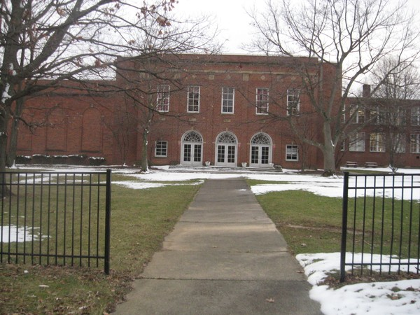



Strategic Plan – 2019 - 2024

Slide 2

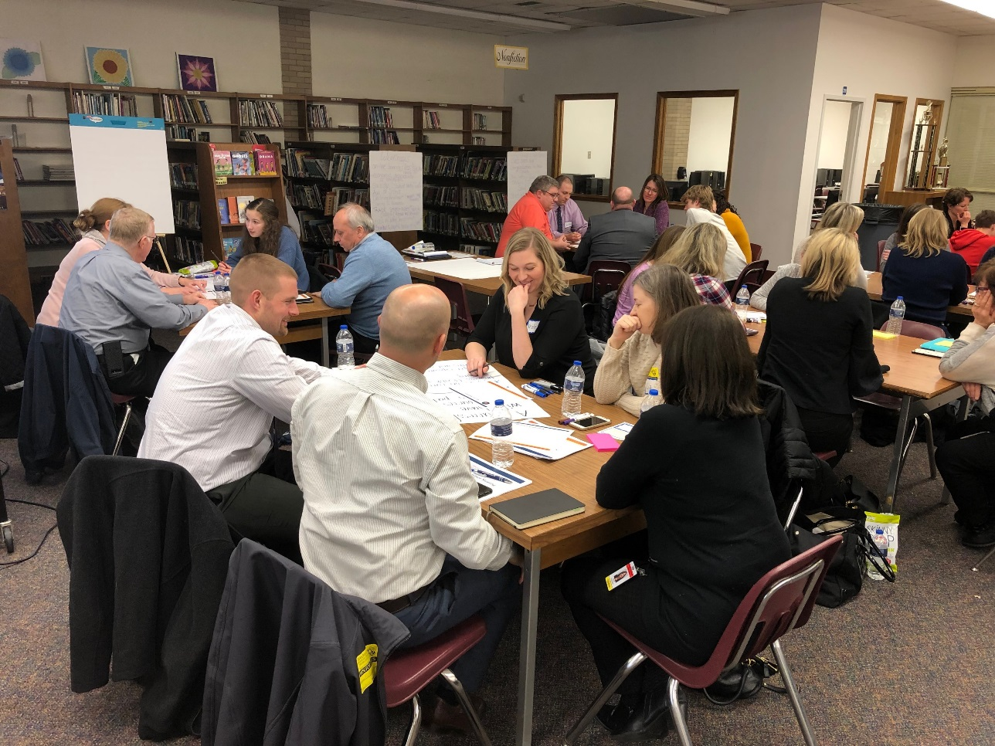
STRATEGIC PLANNING PROCESS
Design and Steering Committees formed
Data review and analysis
Idea Lab Focus Groups
Refine mission, vision
SWOT analysis
Develop strategic objectives and action items
2

Slide 3

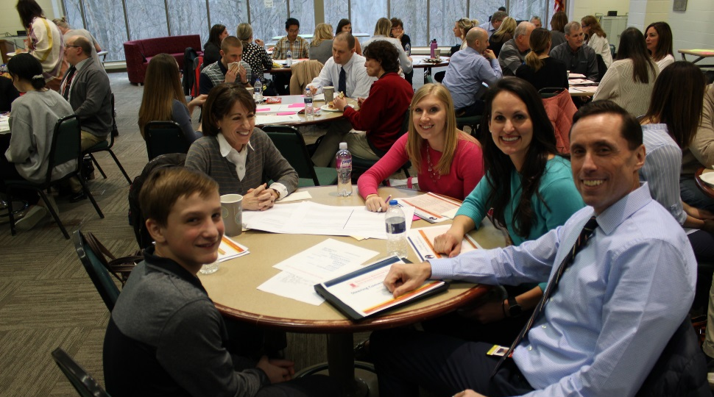
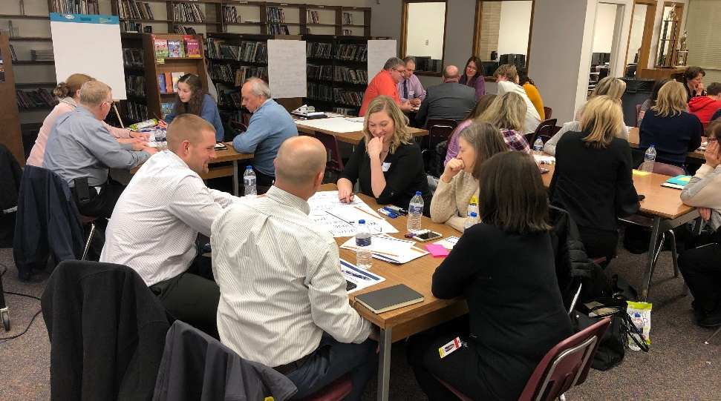
OVER 100 PARTICIPANTS INVOLVED
School Board
Administrators
Staff
Students
Parents
Community
Local Partners
STEERING COMMITTEE
3 meetings
80 participants
DESIGN COMMITTEE
4 meetings, 24 participants
FOCUS GROUPS
6 meetings, 60+ participants
3

Slide 4
MISSION AND VISION STATEMENTS
MISSION:
Preparing our students for their futures.
VISION:
Bee your best, Bee one community, Bee the future.
4

Slide 5
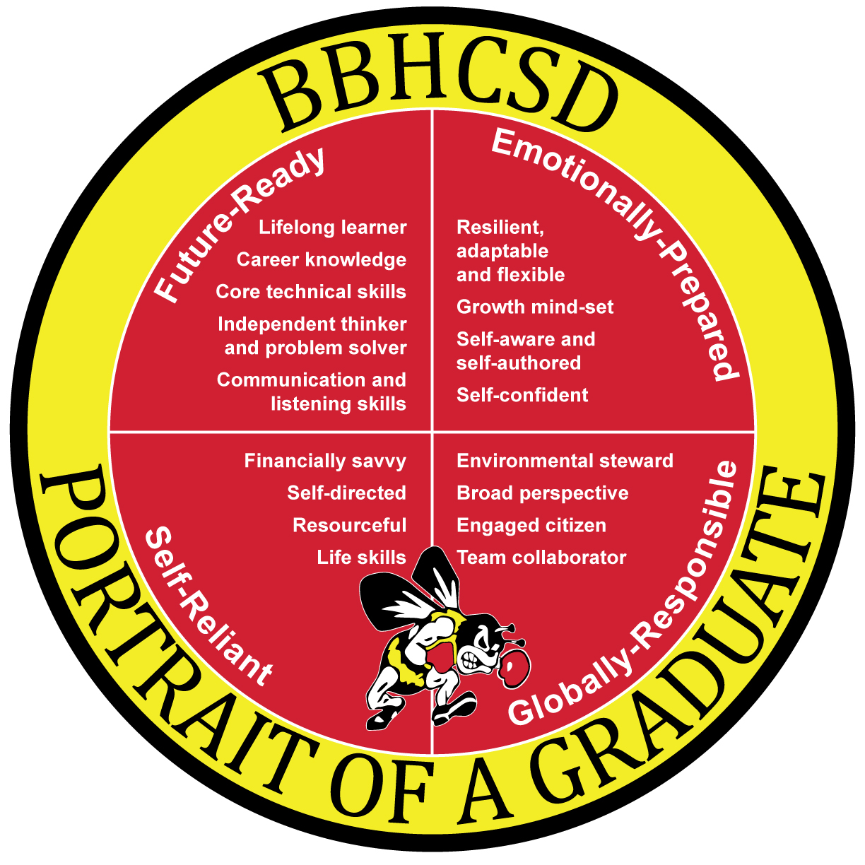
5

Slide 6
STRATEGIC FOCUS AREAS
1. Prepared Students
2. Engaged Community and Families
Career Ready
Instructional Design
Staff Development
Partnerships
Communication
Collaboration with Families
Learning Environments
Programming
Financial Responsibility
Whole Child
Inclusion
Cultural Playbook
3. Responsive Learning Environments
4. Inclusive, Supportive Culture
6

Slide 7
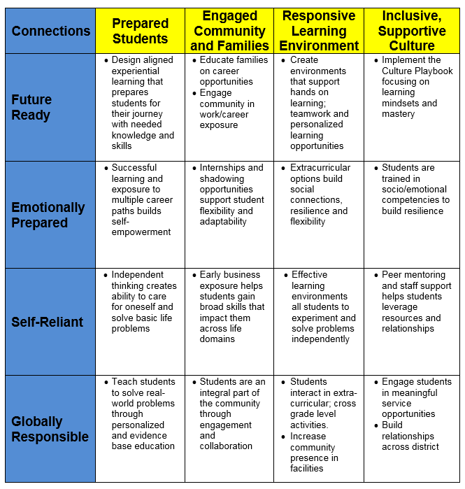
STRATEGY ACHIEVES PORTRAIT
7

Slide 8
STRATEGIC OBJECTIVES
Prepared Students
Implement evidence-based instructional best practices that maximize student learnings
Provide all students grade level appropriate opportunities to explore a variety of careers
Ensure all students have a personalized pathway for graduation and their future
Provide professional learning opportunities that align and engage all staff
8

Slide 9
STRATEGIC OBJECTIVES
Engaged Community and Families
Engage families and community members with ongoing communication
Coordinate and collaborate with parent organizations
Develop mutually beneficial partnerships with local businesses and organizations that create internship and career opportunities for our students
9

Slide 10
STRATEGIC OBJECTIVES
Responsive Learning Environments
Create effective learning environments for student well-being and achievement
Provide engaging programs and extracurriculars so that all students are connected to their school
Ensure fiscal responsibility for the long term sustainability of resources and facilities
10

Slide 11
STRATEGIC OBJECTIVES
Inclusive, Supportive Culture
Live the Culture Playbook throughout the District
Provide support and training for student and staff social / emotional competencies
Address mental health through broad awareness and skill building
Expand service opportunities for students
11

Slide 12
What’s next?
12

Slide 13

THANK YOU!

